Slide 1
Shao Hong Xu
PIT of Push In-basket
2014.09
Product Implementation Training (PIT)
IBM Case Manager 5.2.1
Solution Development Improvements

Slide 2
Introduction
Course Overview
This session covers push in-basket feature in solution development
Target Audience:
IBM Case Manager Support Teams (L2,L3)
ECM Lab Services
IBM GBS and GTS
Technical Sales
Prerequisites:
Working knowledge of ICM 5.2, Solution Design, Page Design and Page Widget/Action
Version Release Date : September, 2014
© Copyright International Business Machines Corporation 2013. All Rights Reserved.
US Government Users Restricted Rights - Use, duplication or disclosure restricted by GSA ADP Schedule Contract with IBM Corp.

Slide 3
Course Objectives
After this course you will
Understand the new push in-basket feature
Know how to configure and use the push in-basket

Slide 4
Course Roadmap
What is push in-basket
Configure push in-basket in designing a page
Use push in-basket to process work items
Course Summary

Slide 5
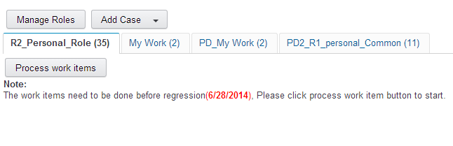
What is push in-basket
Push in-basket prevents case workers selecting which work item to process. Case worker cannot see the work items in the in-basket widget.
Instead, as a case worker completes a work item, the “next” work item is automatically routed to the worker.

Slide 6
Course Roadmap
What is push in-basket
Configure push in-basket in case builder
Use push in-basket in case client
Course Summary

Slide 7
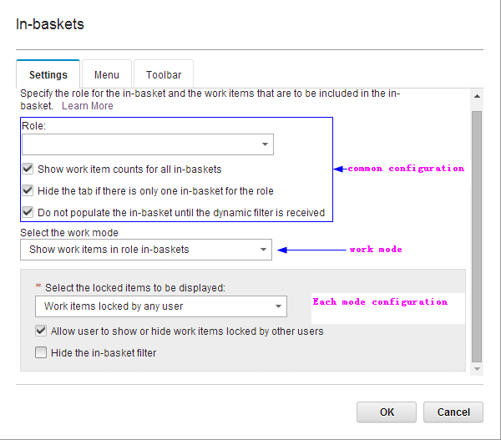
Configure push in-basket (1)
7

Slide 8
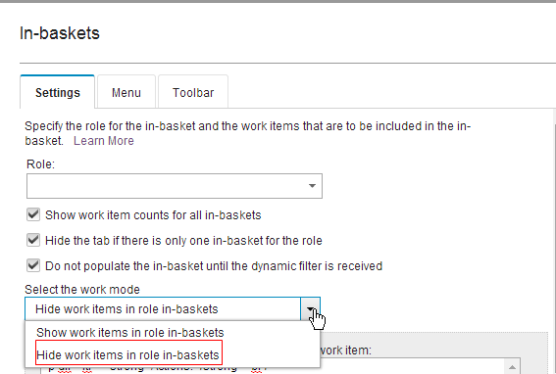
Configure push in-basket (2)
Select Hide work items in role in-baskets.

Slide 9
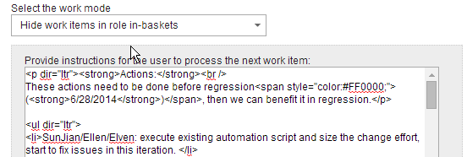
Configure push in-basket (3)
Input instructions for the case worker. The instructions need to be provided as HTML mark up

Slide 10
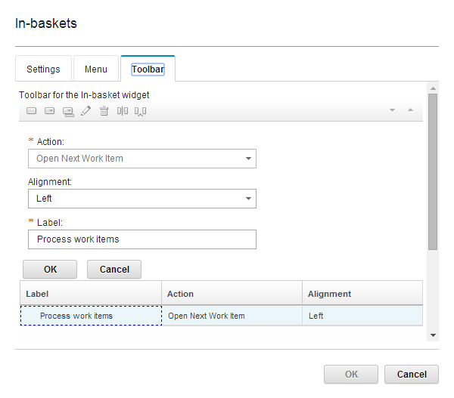
Configure push in-basket (4)
Add Open Next Work Item action to Toolbar

Slide 11
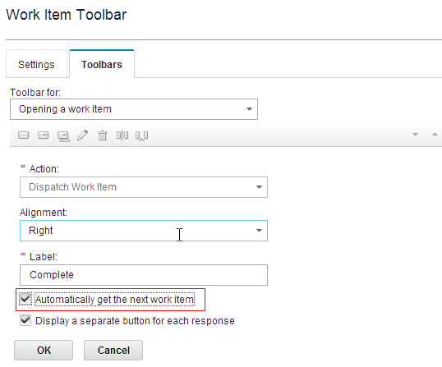
Configure push in-basket (5)
Generally, push in-basket feature needs to work together with the get next work item action in the work item toolbar.
11
Notes:
If you don’t check the automatically get the next work item option, after you dispatch the work item, the page will return to work page. And you have to click process work items to open the work detail page again. Most customers will want to check this item, so that the case worker stays on the work detail page to continue handling next work item

Slide 12
Course Roadmap
What is push in-basket
Configure push in-basket in case builder
Use push in-basket in case client
Course Summary

Slide 13
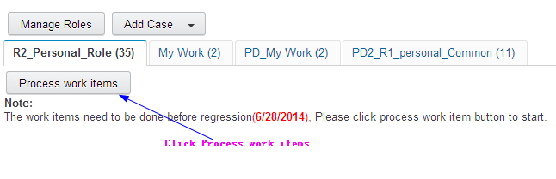
Use push in-basket
In the work page, the case worker clicks the process work items action to start receiving work.
Notes:
Question: Does the case worker click this button once at the beginning of the day, and then a new work item will be assigned to them as soon as they finish their previous work item, or do they click this button each time they want to be assigned a new work item.
Typical scenario is click the button once, the page will jump into work detail page, dispatch work item, the next work item will be retrieved automatically in work detail page. So the case worker continue to handle until there is no more work items

Slide 14
Course Summary
You have completed this course and can:
Configure push in-basket in case builder
Use push in-basket in case client

Slide 15
Contacts
Product Marketing Manager:
William D. (Doc) Mills (wdocmills@us.ibm.com)
Product Manager:
Dave Perman (dperman@ca.ibm.com)
Subject Matter Experts (SME)/Area of Expertise:
Shao Hong Xu(xushaoh@cn.ibm.com)
Support:
Ted Dullanty (tdullanty@us.ibm.com)

Slide 16
Product Help/Documentation/Resources
IBM Case Manager 5.2.1 Knowledge Center: http://pic.dhe.ibm.com/infocenter/casemgmt/v5r2m1/index.jsp
IBM Case Manager 5.2 Knowledge Center:http://www-01.ibm.com/support/knowledgecenter/SSCTJ4_5.2.0/com.ibm.casemgmttoc.doc/casemanager_5.2.0.htm?lang=en
IBM Content Navigator 2.0.3 Knowledge Center:http://www-01.ibm.com/support/knowledgecenter/SSEUEX_2.0.3/com.ibm.usingeuc.doc/euche001.dita?lang=en
IBM FileNet P8 5.2 Knowledge Center: http://www-01.ibm.com/support/knowledgecenter/SSNW2F_5.2.0/com.ibm.p8toc.doc/filenetcontentmanager_5.2.0.htm?lang=en
IBM Support: Fix Central http://www-933.ibm.com/support/fixcentral/

